Slide 1
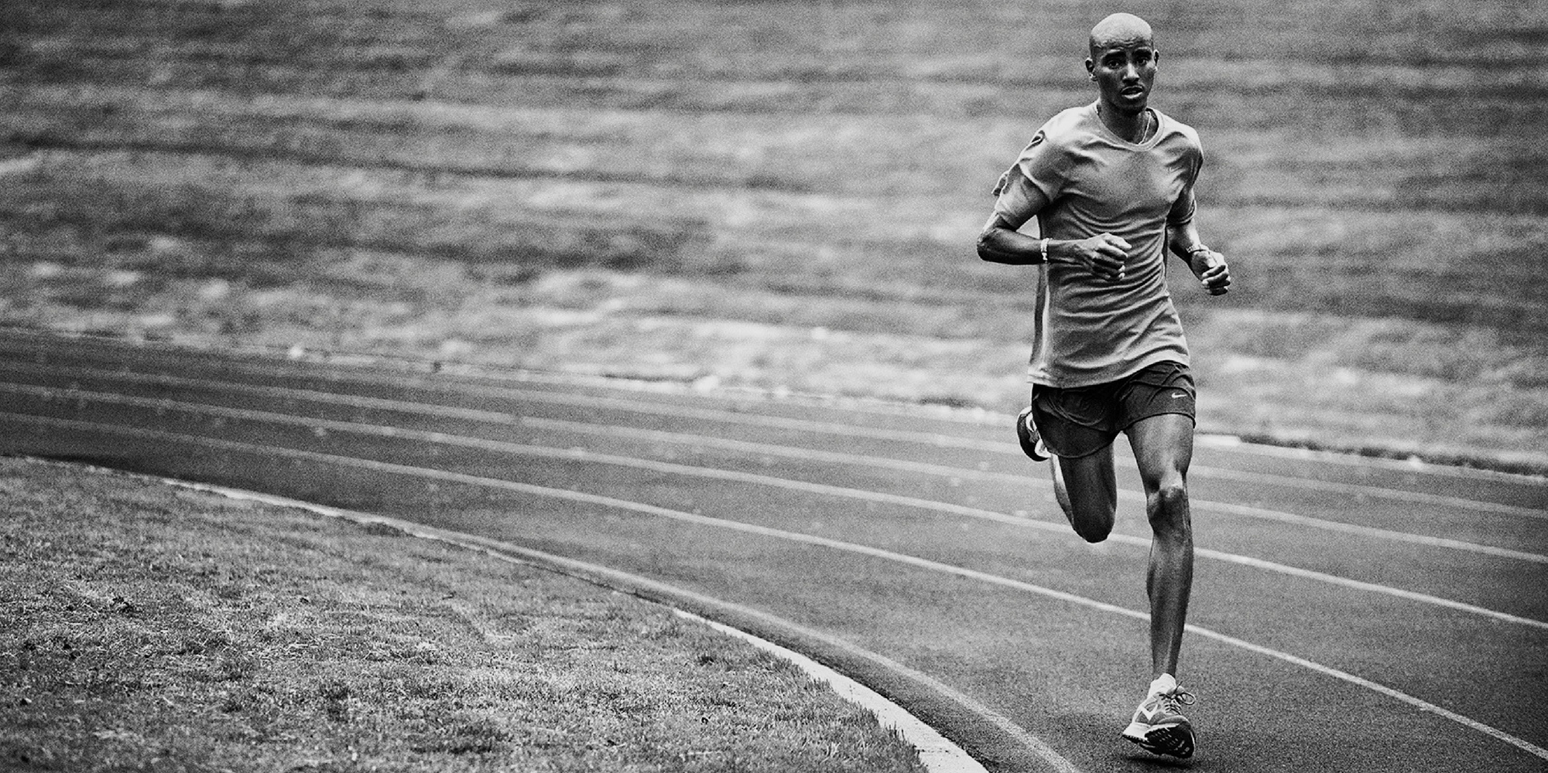
Detecting Athletic Movements With Smart Apparel
D. Alex Lou
Data Scientist | Economist

Slide 2
What’s Currently on the Market?

Slide 3
What’s Currently on the Market?

Slide 4
What’s Currently on the Market?
Single Sensor – Inertial Measurement Unit (I.M.U.)

Slide 5
What If Instead…

Slide 6
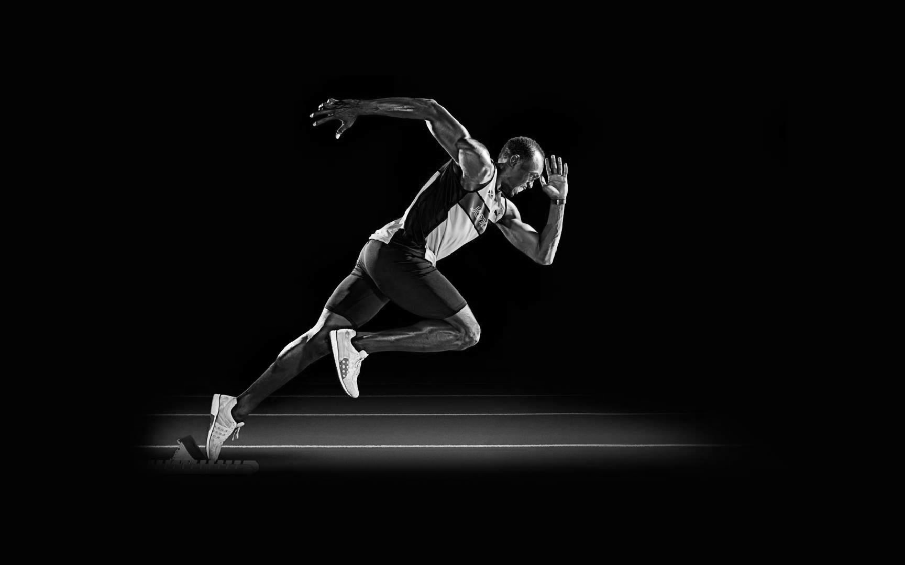
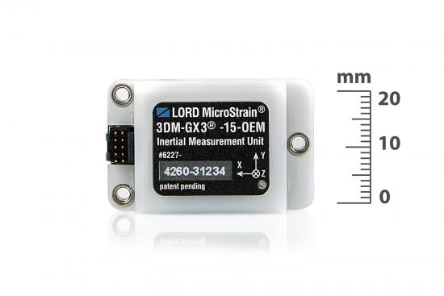
What If Instead…

Slide 7
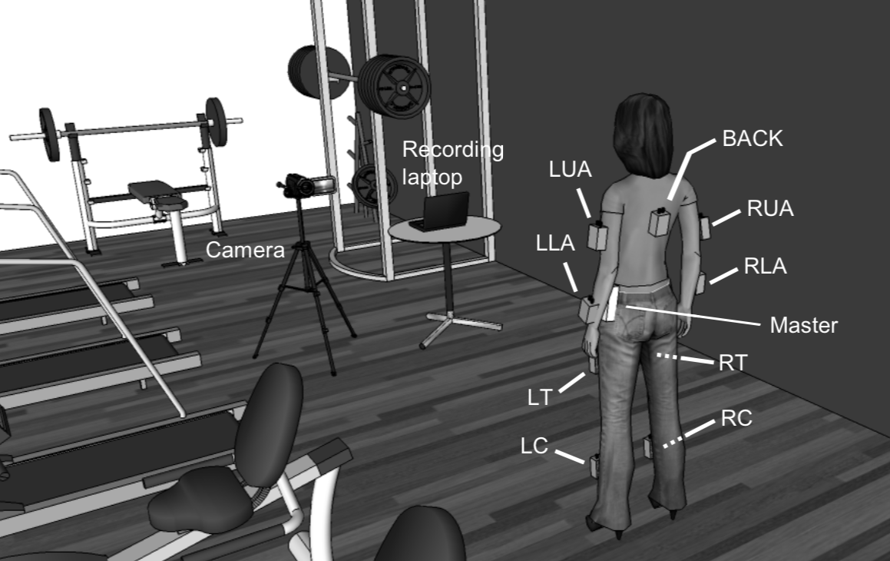
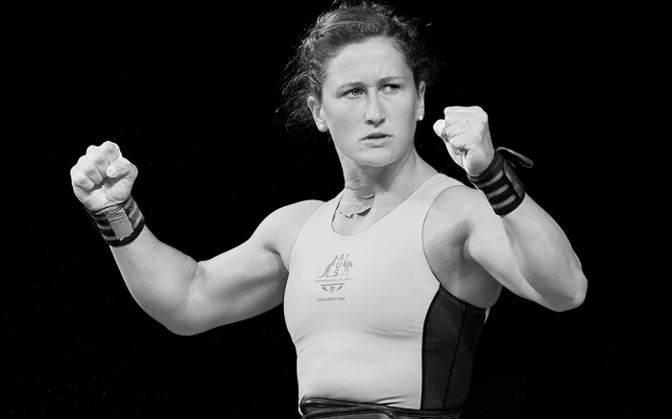
Data
UCI Machine Learning Repository
9 Different Simultaneous I.M.U. Sensors
17 Different Human Subjects
2.6 Million Rows
120 Columns
Key Note:
Panel Data (Time-Series Data For Each Subject)

Slide 8

Data

Slide 9
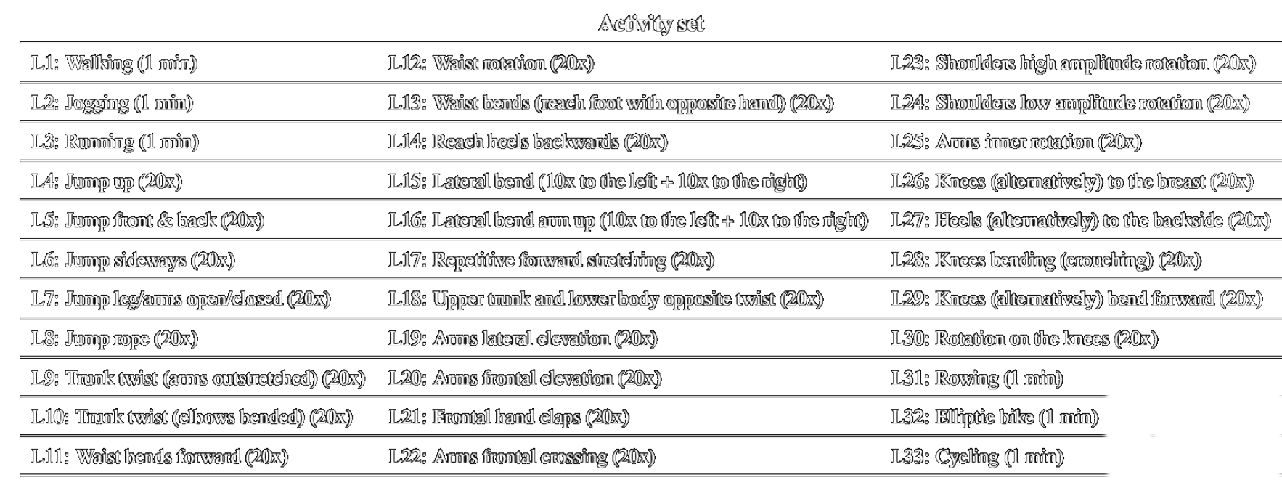
Data

Slide 10
Data

Slide 11
Data

Slide 12
Data

Slide 13
Data

Slide 14
Data

Slide 15
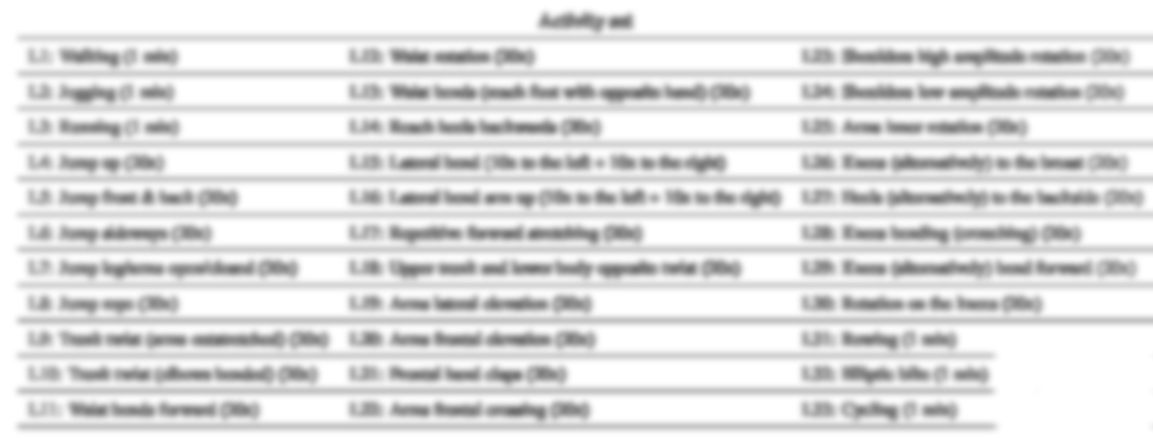
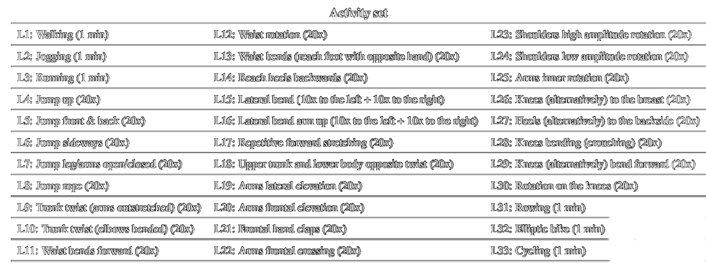
Data
Notes:
Yellow

Slide 16
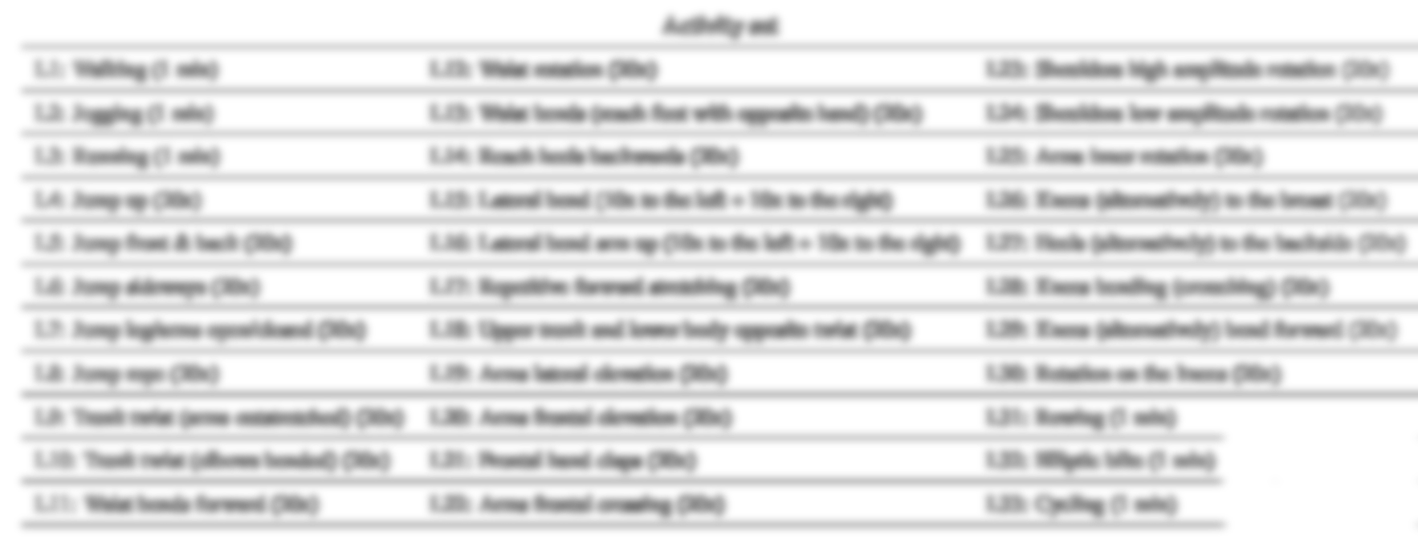
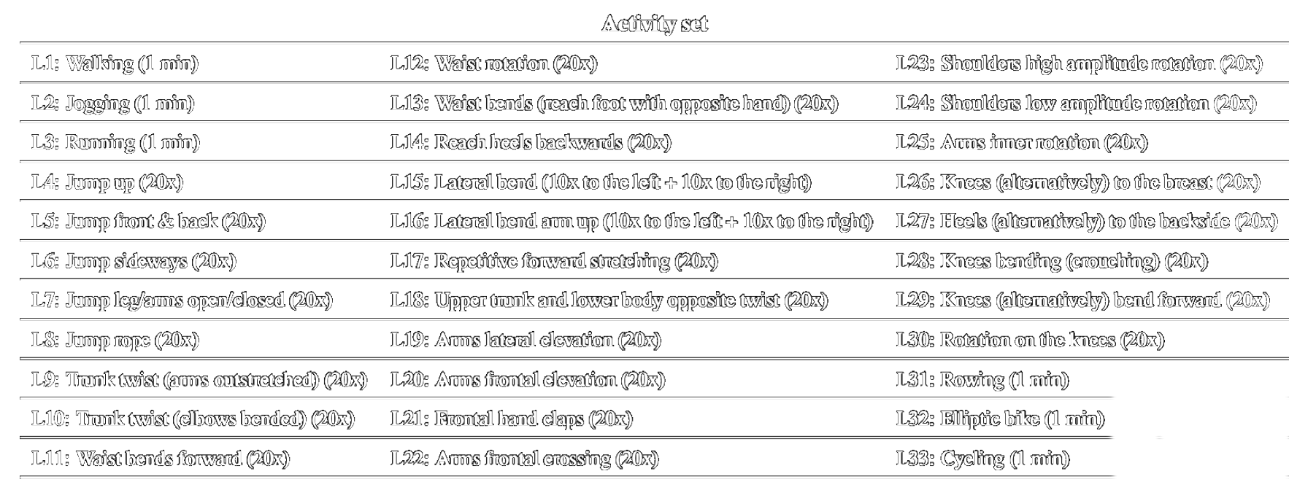
Data
Notes:
Yellow

Slide 17
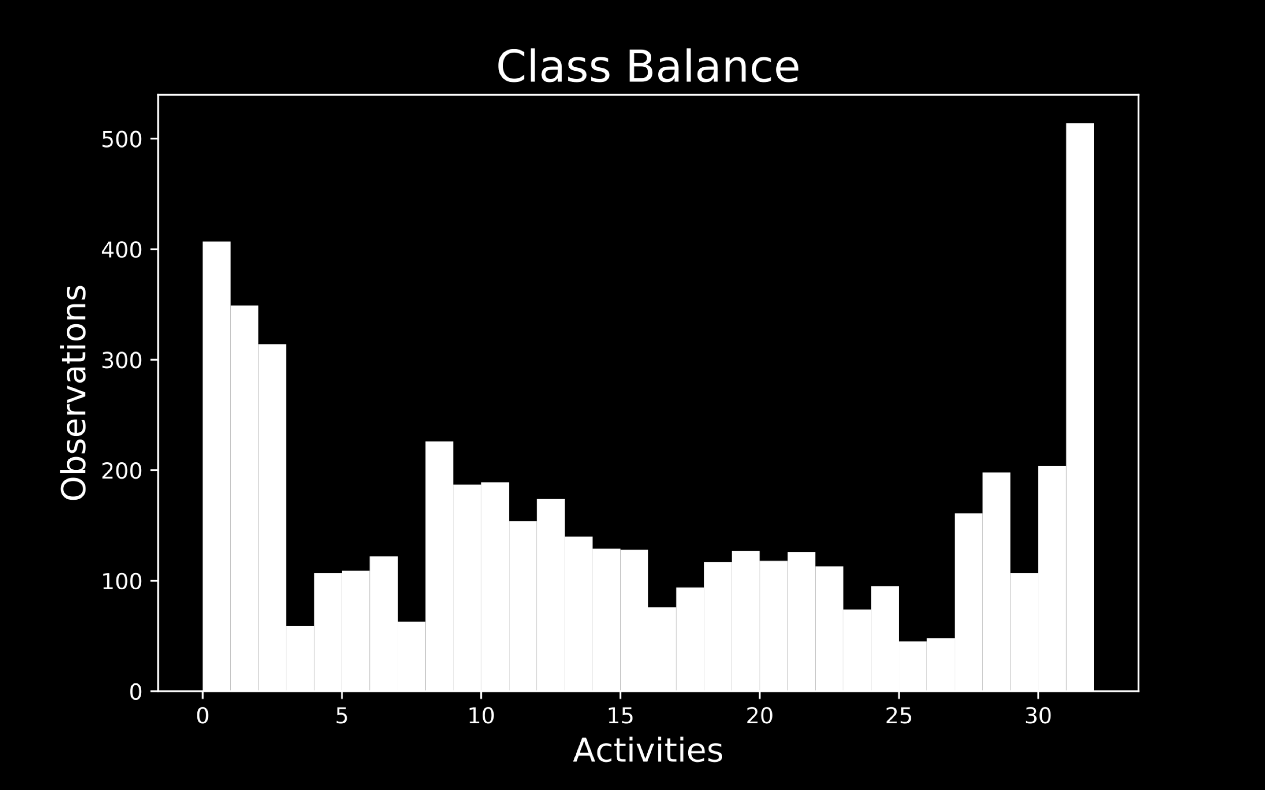
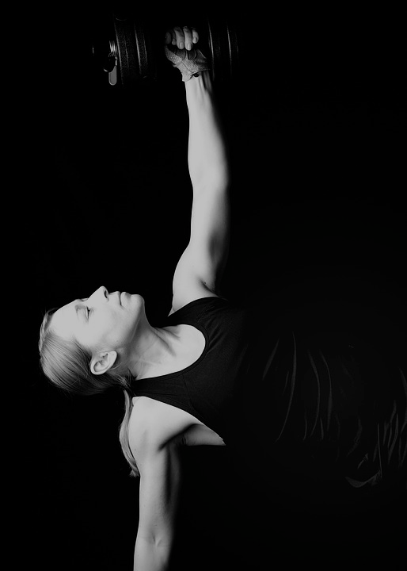

Slide 19


Slide 20
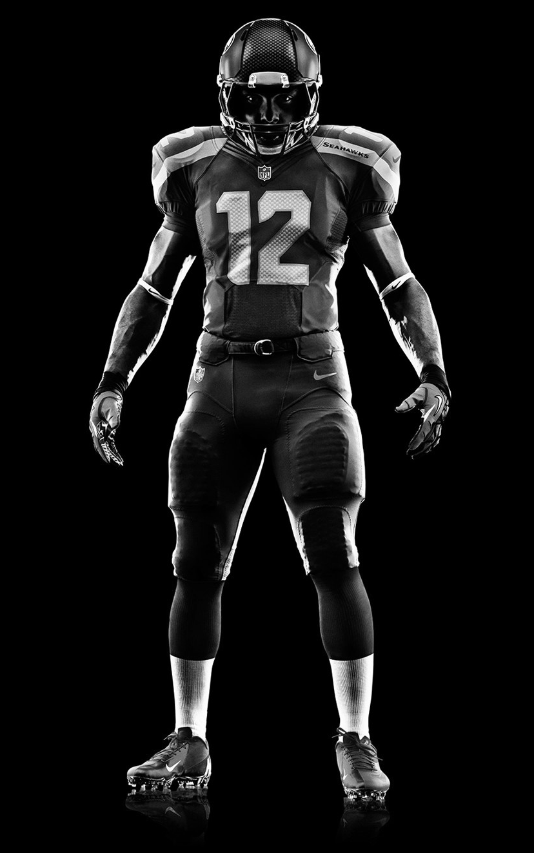

Slide 21
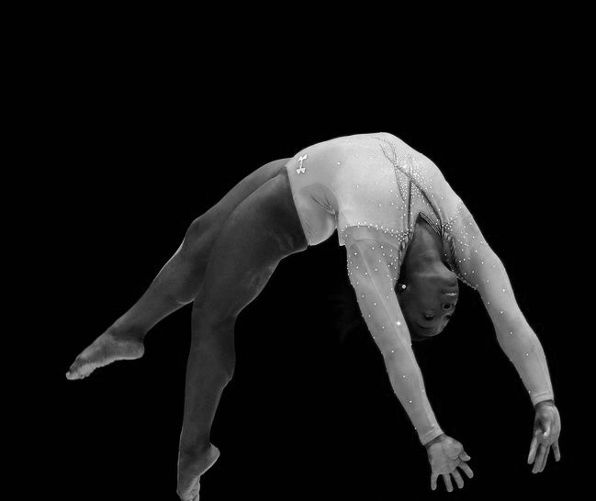

Slide 23


Slide 24


